Slide 1
IN SEARCH OF BEST PRACTICES: BENCHMARKING
OF VOCATIONAL ACCOUNTING EDUCATION MODELS BETWEEN INDONESIA AND MALAYSIA
Presented at Politeknik Harber Tegal
Drs. Sururi, M.B.A., Ak., C.A., C.P.A.
Ketua Forum Program Studi Vokasi (FPSV) – IAI KAPd
Dirktur Politeknik YKPN
17 Januari 2024

Slide 2
VOCATIONAL EDUCATION
Vocational education is education that prepares people to work as a technician or to take up employment in a skilled craft or trade as a tradesperson or artisan.
Vocational Education can also be seen as the type of education given to an individual to prepare that individual to be gainfully employed or self employed with requisite skill.
Vocational education is known by a variety of names, depending on the country concerned, including career and technical education, or acronyms such as TVET (technical and vocational education and training) and TAFE (technical and further education).

Slide 3
VOCATIONAL TRAINING VS ACADEMIC TRAINING
College education often provides theoretical or broad knowledge that could be applied to a variety of professions within a certain field.
Whereas vocational training teaches students the precise skills and knowledge needed to carry out a specific craft, technical skill, or trade.
College education often includes courses on a variety of subjects that may not directly relate to a student’s major and that a graduate may not use in their career.
Whereas vocational school skips this type of broad academic study and instead provides direct knowledge and instruction for a specific field or position.
https://hospitalityinsights.ehl.edu/what-is-vocational-education

Slide 4
VOCATIONAL ACCOUNTING EDUCATION IN INDONESIA
Dictum Kemendikbudristek No.: 27/D/M/2022 tentang Daftar Nama Program Studi Jenis Pendidikan Tinggi Vokasi, pendidikan vokasi akuntansi terdiri dari:
D3 Akuntansi/Accounting
D4 (Sarjana Terapan) Akuntansi, terdiri dari:
A. Akutansi Perpajakan/Tax Accounting
B. Akuntansi Sektor Publik/Public Sector Accounting
C. Akuntansi Bisnis Digital/Digital Business Accounting
D. Akutansi Lembaga Keuangan Syariah/Syariah Accounting

Slide 5
POSITION OF VOCATIONAL EDUCATION VS ACADEMIC EDUCATION IN INDONESIA
FRAMEWORK I
(Formerly)
FRAMEWORK II
(Currenty)
ACADEMIC
INDUSTRY/SOCIETY
ACADEMIC
INDUSTRY/SOCIETY
VOCATION
VOCATION
Link & Match
Link & Match

Slide 6
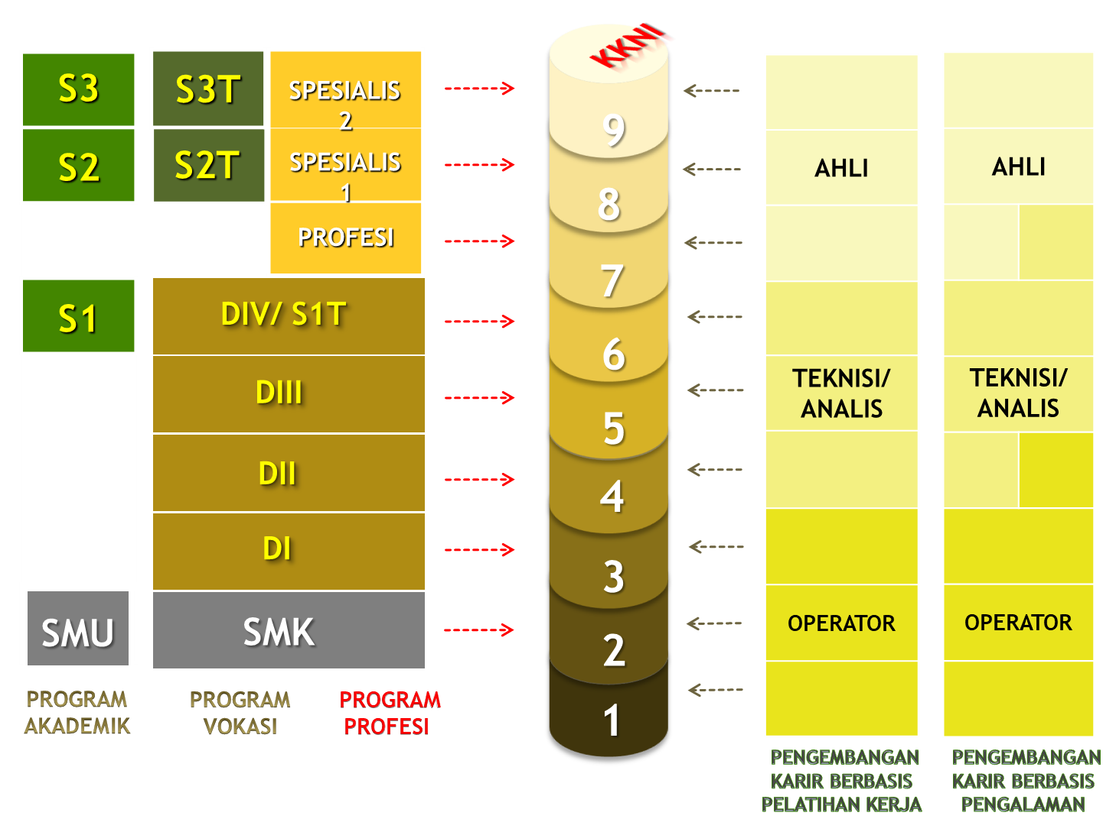
KKNI (KERANGKA KUALIFIKASI NASIONAL INDONESIA)

Slide 7
DESIGN OF EDUCATION FRAMEWORK
Society
Industry
Job Title
Profession
Competency
Requirements
Graduates Profile
Education
Curriculum
EDUCATION PROGRAM – “VOCATIONAL” and “ACADEMIC”
Education is designed to meet competency requirements of society/industry/job title/profession to solve various problems they face, efficiently and effectively.

Slide 8
EDUCATION, CURRICULUM, AND INDUSTRY (SOCIETY)
Education
Soft Skill & Hard Skill
Industry
Society
Link and Match
Keyword of Education
Curriculum
Curriculum are tools which are used to achieve the goal of education
MBKM Curriculum
Outcome Based Curriculum
Competency Based Curriculum
Content Based Curriculum
Endeavor of Curriculum
in Indonesia
to Find the Best Formula
of Link and Match

Slide 9
VOCATIONAL EDUCATION & TRARINING CHAIN
Industry
Industry
Vocational
Education & Training
Internship
(On the Job Training)
Job Placement
Link and Match
No Technology Shortcuts to Good Education (http://edutechdebate.org/ict-in-schools/there-are-no-technology-shortcuts-to-good-education/)

Slide 10
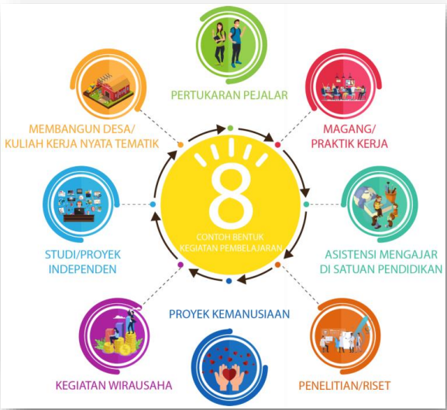
THE CHOICES OF MBKM ACTIVITIES
8 Examples of Learning Activities Form in MBKM Curriculum:
Magang/Praktik Kerja
Asistensi Mengajar di Satuan Pendidikan
Penelitian/Riset
Proyek Kemanusiaan
Kegiatan Wirausaha
Studi/Proyek Independen
Membangun Desa/Kuliah Kerja Nyata Tematik
Pertukaran Pelajar
CONTOH BENTUK
KEGIATAN
PEMBELAJARAN
Remember to Link and Match
Principle

Slide 11
THE CHOICES OF MBKM ACTIVITIES
Form of Learning Activities in MBKM:
Magang/Praktik Kerja
Asistensi Mengajar di Satuan Pendidikan
Penelitian/Riset
Proyek Kemanusiaan
Kegiatan Wirausaha
Studi/Proyek Independen
Membangun Desa/Kuliah Kerja Nyata Tematik
Pertukaran Pelajar
Profile of Graduates
Learning Outcome
(Soft Skill & Hard Skill)
the Choice of Learning Activities
Must Conform With
the Link and Match Principle
as well as the Objectives
of Curriculum’s Learning Outcome

Slide 12
THE VERY IMPORTANT ROLE OF SOFT SKILL
Behind career success story most of people, soft skill giving contribution up to 80%.
Performance achievement of hard skill is highy affected by soft skill performance.
Soft skill is build through:
Co-curriculum activities.
Campus learning ambiance.
Rules of campus living.
Teaching style of lecturers.
Sound relationship among peoples in campus.
Etc.

Slide 13
PRIMARILY PERFORMANCE INDICATORS (IKU)
OF HIGHER EDUCATION TRANSFORMATION

Slide 14
PRIMARILY MANDATORY OF VOCATIONAL ACCOUNTING EDUCATION
Mencetak lulusan yang unggul dalam praktik akuntansi dan penggunaan teknologi pendukung praktik akuntansi, mencakup (IT embedded inside each subject and entrepreneurship skill):
Akuntansi Keuangan
Akuntansi Manajemen
Budgeting
Auditing
Perpajakan
Manajemen Keuangan
Analisis Informasi Akuntansi
Managerial Report
Financial Report

Slide 15
KEY SUCCESS FACTOR IN DEVELOPING VOCATIONAL ACCOUNTING EDUCATION
Kolaborasi yang Kuat dan Produktif antara Pendidikan Vokasi Akuntansi dengan Industri, untuk Penguatan Soft Skill dan Hard Skill Lulusan – dengan dominasi proaktif pada Pendidikan Vokasi.
Institusi Pendidikan Vokasi Menjadi:
Rumah produksi inovasi pendidikan akuntansi berbasis kasus (CBL) dan berbasis projek (PBL)
Rumah produksi solusi problem praktik akuntansi.
Rumah produksi inovasi praktik akuntansi.

Slide 16
THE BRIGHT PROSPECT OF VOCATIONAL ACCOUNTING EDUCATION
PROSES BISNIS INDUSTRI
Accounting
Accounting
1. PRODUCT DESIGN
The Main Concern:
Potential Error
Potential Fraud
Innovation Problems
Informasi akuntansi dan keuangan menjadi pertimbangan dan perhatian utama pada setiap tahap proses bisnis.
2. PRODUCTION PLANING
3. BUDGETING
4. PRODUCTION PROCESS
5. SELLING
6. MONITORING & EVALUATION

Slide 17
10 Essential Accountant Competencies That Employers Seek
Research skills: Data collection, Analysis, Attention to detail
Financial reporting: Balance sheet, Income statement, Statement of equity changes, Cash flow statement.
Budgeting and forecasting
Spreadsheet proficiency
Accuracy
Time management: Organization, Prioritization, Planning, Delegation, Problem-solving
Updated December 21, 2023
https://www.indeed.com/career-advice/career-development/accountant-competencies

Slide 18
10 Essential Accountant Competencies That Employers Seek
Business acumen: Strategic thinking, Technology skills, Negotiation, Team-building, Creativity
Mathematical skills: Basic arithmetic, Statistics, Algebra, Mathematical modelling, Calculus
Communication: Confident speaking voice and non-verbal cues, Presentation skills, Clear and concise language.
Teamwork: Leadership, Collaboration, Listening, Empathy, Conflict resolution.
Updated December 21, 2023
https://www.indeed.com/career-advice/career-development/accountant-competencies

Slide 19
Accounting Competencies - AICPA
Accounting competencies are the technical competencies of the profession that add value to business and contribute to a prosperous society.
Risk Assessment, Analysis and Management Assess, analyze and manage risk using appropriate frameworks, professional judgment and skepticism for effective business management.
Measurement Analysis and Interpretation Identify and apply appropriate, reliable, and verifiable measurements to analyze data for a given purpose and intended use.
Reporting Identify the appropriate content and communicate clearly and objectively to the intended audience, the work performed and the results as governed by professional standards, required by law or dictated by the business environment.
AICPA
https://us.aicpa.org/interestareas/accountingeducation/resources/accounting-core-competencies-functional

Slide 20
Accounting Competencies - AICPA
Research Identify, access and apply relevant professional frameworks, standards, and guidance, as well as other information for analysis and to make informed decisions.
Systems and Process Management Identify the appropriate businesses processes and system(s), related frameworks and controls to assist in the design and use of systems for efficient and effective operations.
Technology and Tools Identify and utilize relevant technology and tools to analyze data, efficiently and effectively perform assigned tasks as well as support other competencies.
AICPA
https://us.aicpa.org/interestareas/accountingeducation/resources/accounting-core-competencies-functional

Slide 21
Professional Competencies - AICPA
Professional competencies relate to the skills, attitudes and behaviors of accounting professionals.
Ethical Conduct Behave in a manner bound by ethical principles for the protection of society, including upholding the AICPA Code of Professional Conduct.
Professional Behavior Practice in a manner consistent with the character and high standards set by the AICPA and the accounting profession. Demonstrate a work ethic and respect for diversity, as well as a commitment to continuously acquire new personal and professional skills and knowledge.
Decision Making Objectively identify and critically assess the issues and use professional judgment to develop appropriate decision models, identify and analyze the costs and benefits of alternative courses of action and recommend optimal solutions.
AICPA
https://us.aicpa.org/interestareas/accountingeducation/resources/accounting-core-competencies-personal

Slide 22
Professional Competencies - AICPA
Collaboration Work productively with diverse individuals in a variety of roles, with multiple interests in the outcome, to achieve acceptable and optimal results.
Leadership Know and apply models of leadership to influence, inspire and motivate diverse individuals and groups. Develop attitudes and behaviors that recognize diversity and promote inclusion, and optimize individual and organizational performance.
Communication Actively listen and effectively deliver information in multiple formats tailored to the intended audience.
Project Management Plan and manage individual and team work flow through effective utilization of time and other resources to accomplish objectives.
AICPA
https://us.aicpa.org/interestareas/accountingeducation/resources/accounting-core-competencies-personal

Slide 23
THANK YOU

